Slide 1
Lecture : 1 and 2
Economics,
Scarcity,
Choice,
Specialization and Exchange,
Marginal Analysis and Decisions,
Microeconomics and Macroeconomics,
The Common Fallacies in Economics,
Positive Economics and Normative Economics,
Positive and Negative relationship,
Dependent and independent variables,
The rules for constructing graphs,
Slope,
The key problems of an Economics Organization,
Different Economic Systems,
Opportunity Costs,
The Production Possibilities Frontier.
1

Slide 2
Economics,
People are concerned with improving their standard of living; they are worried about inflation and unemployment; they may be distributed by the poverty of the less fortunate. People are confronted with difficult personal choice: when to by a home, whether to change jobs, whether to attend college. People are often confused by the economic claims and counterclaims of opposing political parties. People can find help in dealing with these questions and concerns in the study of Economics.

Slide 3
Economics,
The word “Economics” comes from the word “Household Management”. The effective birth of economics as a separate discipline may be traced to the year 1776, when the Scottish philosopher Adam Smith published An Inquiry into the Nature and Causes of the Wealth of Nations.
He separated Economics as a separate branch from the word household management. So, Adam Smith is a Father of Economics. .

Slide 4
Economics,
There was, of course, economics before Smith: the Greeks made significant contributions, and from the 15th to the 18th century an enormous amount of pamphlet literature discussed and developed the implications of economic nationalism (a body of thought now known as mercantilism).
It was Smith, however, who wrote the first full-scale treatise on economics and, by his magisterial influence, founded what later generations were to call the “English school of classical political economy,” known today as classical economics.

Slide 5
Economics,
According to Adam Smith, “An Enquiry into the Nature and Causes of Wealth of Nations”.
According to the French economist John Baptist Say, “Economics is the science which treats of wealth”.
According to the American economist F. A. Walker, “Economics is the body of knowledge which relates to wealth”.
According to the Marshall, “Economics is the study of mankind in the ordinary business of life”.
According to Robbins, “ Economics is the science which studies human behaviour as a relationship between ends and scarce means which have alternative uses”. (1932,) An Essay on the Nature and Significance of Social Science,

Slide 6
From the above definitions we may summarize as follows : “ Economics is the branch of social science which concerned with the proper uses and allocation of limited resources for the achievement and maintenance of development and growth with stability”. Alternatively we may define, “ Economics is the study of how people choose to use their limited resources, i.e., land, labour and capital goods like trucks and machinery and buildings to produce, exchange and consume goods and services.

Slide 7
What does rural planning mean?
Rural planning is the process of improving the quality of life and economic well-being of communities living in relatively unpopulated areas rich in natural resources. Rural development has traditionally focused on the exploitation of natural resources such as agriculture, forestry and mining.

Slide 8
What is urban planning planning?
Urban planning encompasses the preparation of plans for and the regulation and management of towns, cities, and metropolitan regions. It attempts to organize socio spatial relations across different scales of government and governance.

Slide 9
Scarcity
Scarcity :
Scarcity is the distinguishing characteristic of an economic good. An economic good is scarce does not mean that it is rare, but only that is not freely available for taking. To obtain such a good, one must either produce it or offer other economic goods in exchange. An item is a scarce good if the amount available, i.e., offered to users, is less than the amount people want if it would be given away free of charge.
A free good is one where the amount available is greater than the amount people want at a zero price.

Slide 10
Choice
Choice and scarcity go together. Individuals, businesses, and societies must choose among alternatives. An individual must choose between a job and a college education, between savings and consumption, between a movie and eating out. Businesses must decide where to purchase supplies, which products to offer on the market, how much labour to hire, whether to build new plants. Nations must choose between more defenses or more spending for social-welfare programs; they must decide whether to grant tax reductions to business or to individuals.

Slide 11
Specialization and Exchange
Specialization : Economics studies how participants in the economy, i.e., people, businesses, and countries, specialize in tasks to which they are particularly suited. The physician specializes in medicine, the lawyer in law, the computer scientist in data processing, the economics professor in teaching economics.
Exchange : Exchange complements specialization. Without exchange, specialization would be of no benefit because individuals could not trade the goods in which they specialize for those that other individuals produce.

Slide 12
Marginal Analysis and Decisions
Scarcity forces people to make choice and economics studies how these choices are made. The most important tool used by economists to study economic decision making is Marginal Analysis. Marginal analysis aids decision making by examining the consequences of making relatively small changes from the current state of affairs. Decisions are made at the margin when a decision maker considers what the extra or marginal costs and benefits of an increase or decrease in a particular activity will be. If the marginal benefits outweigh the marginal costs, the extra activity is undertaken.

Slide 13
Microeconomics and Macroeconomics
Microeconomics studies the economic decision making of firms and individuals in a market setting; it is the study of the economy in the small.
Macroeconomics is the study of the economy in the large. Rather than dealing with individual markets and individual consumers and producers, macroeconomics deals with the economy as a whole.

Slide 14
The Common Fallacies in Economics
If statements appear to be logical and to be based upon facts, and they will probably be accepted by the average reader without much hesitation. Yet close examination of these statements reveals that they exemplify three logical fallacies that plague economic thinking. These fallacies are the false-cause fallacy, the fallacy of composition and the ceteris paribus fallacy.
The False-Cause Fallacy : The false-cause fallacy is the assumption that because two events occur together one event has caused the other. A statistical correlation between two variables does not prove that one has caused the other or that the variables have anything whatsoever to do with one another.

Slide 15
The Fallacy of Composition : The fallacy of composition is the assumption that what is true for each part taken separately is also true for the whole or that what is true for the whole is true for each part considered separately.
The Ceteris Paribus Fallacy : The ceteris paribus fallacy occurs when the effects of changes in one set of variables are incorrectly attributed to another set of variables. Ceteris paribus is a Latin term meaning, “Other things being equal”. If the relationship between two variables is to be established the effects of other factors that are changing as well must not be allowed to confuse the relationship.

Slide 16
Positive Economics and Normative Economics
Positive economics is concerned with those statements which relate to the actual observations of economic phenomena in the real world.
Normative economics is concerned with what ought to be in the economy. It involves value judgments and individual’s likings and disliking; consciously or unconsciously; creep in.
Examples : Any economist will predict that if the government imposes a tax on a good, the prices of that good will rise.

Slide 17
Positive Economics and Normative Economics
Say, if the government was to impose a tax on patrol or octane, the prices of those goods would rise, which the example of positive economics .
Government try to establishes income tax systems that take relatively more from the rich than from the poor, recommendations to subsidize the high price of gasoline to avoid a large burden on the poor and recommendations to cut taxes on the rich to achieve faster economic growth. In each instance the economist looks at a particular goal that he favours on the basis of personal preferences.

Slide 18
Positive and Negative relationship
A positive or direct relationship exists between two variables if an increase in the value of on variable is associated with an increase in the value of the other variable, i.e. change will be in same direction. A negative or inverse relationship exists between two variables if an increase in the value of one variable is associated with a reduction in the value of other variable, i.e., change will be in opposite direction.

Slide 19
Dependent and independent variables
A change in the value of an independent variable will cause the dependent variable to change in value. In the function, is referred to as the argument of function, and is called the value of the function. We shall also alternatively refer to as the independent variable and as the dependent variable.

Slide 20
The rules for constructing graphs
At first we consider a following schedule :
Combinations | Minutes of Typing ( X axis) | Number of Pages Typed ] ( Y axis)
0 | 0 | 0
A | 5 | 1
B | 10 | 2
C | 15 | 3
D | 20 | 4

Slide 21
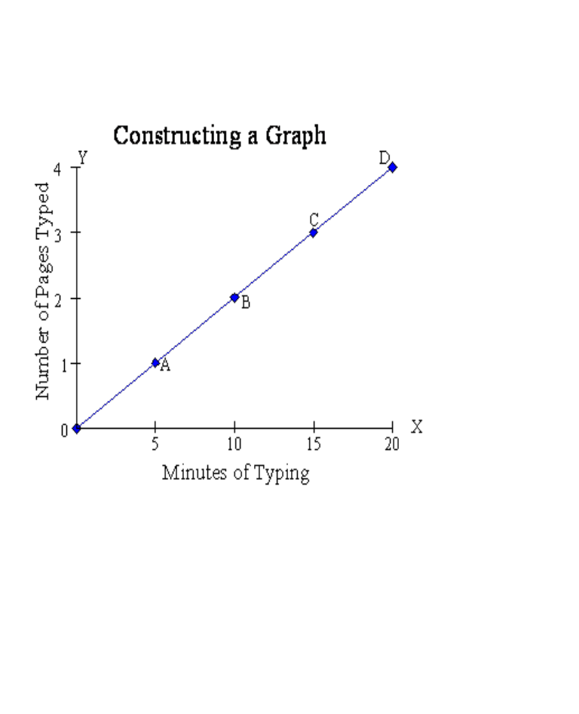
Four steps are required to graph these data or any data. These steps have been carried out in the above figure.

Slide 22
A vertical axis and a horizontal axis are drawn perpendicularly on graph paper, meeting at a point called the origin. The origin is labeled 0; the vertical axis is labeled; the horizontal axis is labeled.
Minutes of typing are marked off along the horizontal axis in equally spaced increments of 5 minutes, and the horizontal axis is labeled “Minutes of Typing.”
The number of pages typed is marked off in equally spaced increments of 1 page along the vertical axis, and the vertical axis is labeled “Number of Pages Typed.”
Each pair of numbers in the following table is plotted at the intersection of the vertical line that corresponds to that value of and the horizontal line that corresponds to that value of. Point A shows that 5 minutes of typing produces 1 page. Point B shows those 10 minutes of typing produces 2 pages, and so on. Point A, B, C, and D completely describe the data in the above table.

Slide 23
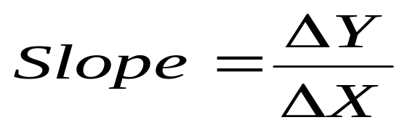
Slope
The relationship between two variables is represented by a curve’s slope. The slope reflects the response of one variable to changes in another.
Let (delta) stand for the change in the value of and (delta) stand for the change in the value of. So,

Slide 24
The key problems of an Economics Organization
The economic problem is how to allocate scarce resources among competing ends. Three questions must be answered : What products will be produced ? How will they be produced?, For whom will they be produced?
What ? : Should society devote its limited resources to producing civilian or military goods, luxuries or necessaries goods, goods for immediate consumption or goods that increase the wealth of society, i.e., capital goods ? Should small or large cars be produced, or should buses and subways be produced instead of cars ? Should the military concentrate on strategic or conventional forces ?

Slide 25
The key problems of an Economics Organization
How ? : Once the decision is made on what to produce, society must determine what combinations of the factors of production will be used. Will coal, petroleum, or nuclear power be used to produce electricity ? Will bulldozers or workers with shovels dig dams ? Should automobile tires be made from natural or synthetic rubber? Should Coca Cola be sweetened with sugar or corn syrup ? Should tried-and-true methods of production be replaced by new technology?

Slide 26
For Whom ? : Will society’s output be divided fairly equally or will claims to society’s output be unequal ? Will differences in wealth be allowed to pass from one generation to the next ? What role will government play in determining for whom ? Should government intercede to change the way the economy is distributing its output ?

Slide 27
Different Economic Systems
What are the different ways that a society can answer the questions of what, how and for whom ? Different societies are organized through alternative economic systems, and economics studies the various mechanisms that a society can use to allocate its scare resources. We generally distinguish two fundamentally different ways of organizing an economy. At one extreme, government makes most economic decisions, with those on top of the hierarchy giving economic commands to those further down the leader.

Slide 28
At the other extreme, decisions are made in markets, where individuals or enterprises voluntarily agree to exchange goods and services, usually through payments of money. Let’s explain each of these forms:
In the United States and most democratic countries, most economic questions are solved by the markets. Hence their economic systems are called market economies.

Slide 29
A Market Economy is one in which individuals and private firms make the major decisions about production and consumption. A system of prices, of markets, of profits and looses, of incentives and rewards determines what, how and for whom. Firms produce the commodities that yield the highest profits, i.e. the what, by the techniques of production that are least costly, i.e., the how. Consumption is determined by individuals’ decisions about how to spend the wages and property incomes generated by their labour and property ownership, i.e., for whom. The extreme case of a market economy, in which the government keeps its hands off economic decisions, is called a laissez-faire economy.

Slide 30
By contrast, a Command Economy is one in which the government makes all important decisions about production and distribution. In a command economy, such as the one which operated in the Soviet Union during most of the century, the government owns most of the means of production, i.e., land and capital; it also owns and directs the operations of enterprises in most industries; it is the employer of most workers and tells them how to do their jobs; and it decides how the output of the society is to be divided among different goods and services. In short, in a command economy, the government answers the major economic questions through its ownership of resources and its power to enforce decisions.

Slide 31
No contemporary society falls completely into either of these polar categories. Rather, all societies are Mixed Economies, with elements of market and command.
Today most decisions in the United States are made in the marketplace. But the government plays an important role in overseeing the functioning of the market; government pass laws that regulate economic life, produce educational and police services, and control pollution. Most societies today operate Mixed Economies.

Slide 32
Opportunity Costs
A sacrificed opportunity is called an opportunity cost by economists because the economic cost of any choice is that which must be sacrificed in order to make that choice. The opportunity cost of a particular action is the loss of the next best alternative.

Slide 33
Opportunity Costs
What is opportunity cost?
We can define opportunity cost as the potential benefits that are lost when an individual, business or investor chooses a substitute over another. As the opportunity cost definition defines it to be hidden, the costs could go unnoticed very easily. To make a better decision it is important for a business to understand the possible missed opportunities whenever a business chooses one investment over another.

Slide 34
opportunity cost
Opportunity cost is the forgone benefit that would have been derived from an option not chosen.
To properly evaluate opportunity costs, the costs and benefits of every option available must be considered and weighed against the others.
Considering the value of opportunity costs can guide individuals and organizations to more profitable decision-making.

Slide 35
Opportunity cost
Opportunity cost is a strictly internal cost used for strategic contemplation; it is not included in accounting profit and is excluded from external financial reporting.
Formula and how to calculate Opportunity cost
Opportunity cost = FO – CO
Where: FO stands for Return on best-forgone selection and
CO stands for return on the selected option.

Slide 36
opportunity cost
The formula to calculate the opportunity cost is nothing but the difference between the returns that are expected from each selection.
Suppose we have option A i.e. we invest in the stock market and hope to make capital gain returns. In the meantime, we have option B which says we reinvest our money into our business and buy new equipment that will enhance the efficiency of the production. As a result, operational expenses will decrease and profit margin would increase.

Slide 37
opportunity cost
If we make an assumption that the return on investment when investing in the stock market is 12 per cent. However, your company would generate a 10 per cent return when provided with an equipment upgrade in the same period. If we choose to upgrade the equipment and not invest in the stock market, then the opportunity cost would be 12 – 10 per cent. We can also say that if we invest in our business we would lose the opportunity to earn more profits.

Slide 38
Production Possibilities Frontier (PPF)
The Production Possibilities Frontier (PPF) is a graph that shows all the different combinations of output of two goods that can be produced using available resources and technology. The PPF captures the concepts of scarcity, choice, and tradeoffs.
The shape of the PPF depends on whether there are increasing, decreasing, or constant costs.

Slide 39
Points that lie on the PPF illustrate combinations of output that are productively efficient. We cannot determine which points are allocatively efficient without knowing preferences
The slope of the PPF indicates the opportunity cost of producing one good versus the other good, and the opportunity cost can be compared to the opportunity costs of another producer to determine comparative advantage.

Slide 40
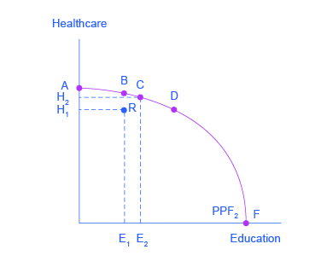
Society has limited resources (e.g., labor, land, capital, raw materials) at any point in time, there is a limit to the quantities of goods and services it can produce. Suppose a society desires two products, healthcare and education. This situation is illustrated by the production possibilities frontier in this graph.
This production possibilities frontier shows a tradeoff between devoting social resources to healthcare and devoting them to education. At A all resources go to healthcare and at B, most go to healthcare. At D most resources go to education, and at F, all go to education.

Slide 41
Productive efficiency means it is impossible to produce more of one good without decreasing the quantity that is produced of another good. Thus, all choices along a given PPF like B, C, and D display productive efficiency, but R does not. Allocative efficiency means that the particular mix of goods being produced—that is, the specific choice along the production possibilities frontier—represents the allocation that society most desires.

Slide 42
The society could choose to produce any combination of healthcare and education shown on the production possibilities frontier.. Society can choose any combination of the two goods on or inside the PPF. But it does not have enough resources to produce outside the PPF.

Slide 43
Book References
Economics
by Paul Samuelson , William Nordhaus
Principles of Economics,
by N. Gregory Mankiw

